Slide 1
Agenda
No. | Topic
1. | Strategy Objective
2. | Data Collection and Verification
3. | Trading Strategy
4. | Portfolio Optimization
5. | Back Test Results and Conclusions

Slide 2
Strategy Objective
Develop an investment strategy that seeks to generate consistent returns through a selection of commodity-linked component sub-indices
Identify a L/S strategy to generate trading signals based on commodity price movements
Identify a portfolio optimization technique to minimize portfolio beta and variance for the generated trading signals

Slide 3
Commodities Market Neutral Investment Strategy
Group 3: Jack Bartoluzzi, Jim Burrill, Tim Lee, Sagar Mirchandani, Kevin Yang, Hanbo Yu, Hamza Zbiri

Slide 4
Overview
Data Ingestion
Trading Signal Generation
Portfolio Rebalancing Identification
Portfolio Optimization
Performance Analysis

Slide 5
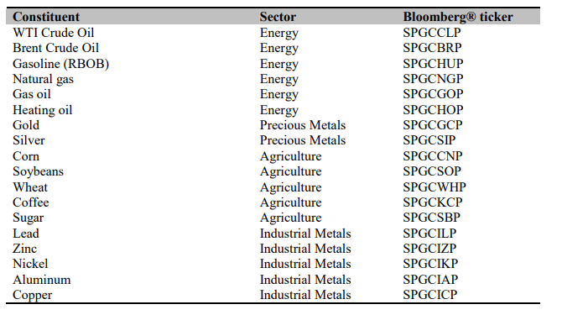
Data Collection and Verification
Note: BCOM was utilized as a benchmark for strategy performance
Data Cleaning
Trading Strategy
Optimization
Back Test
Notes:
Data Sources – Bloomberg provided cleaned and full data
Only gaps in data where found in BCOM, forward fill was utilized
Checked data for outliers and potential biases

Slide 6
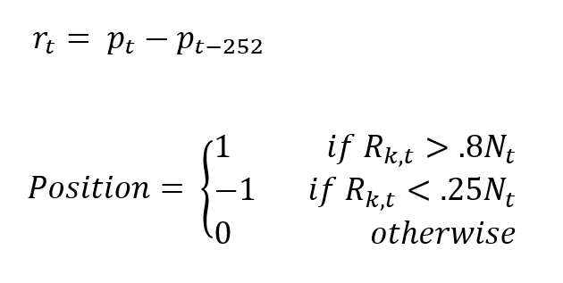
Trading Strategy – AQR Momentum
Utilized a momentum strategy based on 1-year trailing returns
r_{t} = 1 Year Trailing Return at Time t
p_{t} = Price at Time t
N_{t} = Number of Commodities in Investible Universe at Time t
R_{k,t} = Rank of r_{t} of Security K in Investible Universe at Time t
Note: 0.8 and 0.25 were chosen such that the same number of L/S positions were opened at a given time based on the number of available commodities in the investible universe.
Data Cleaning
Trading Strategy
Optimization
Back Test

Slide 7
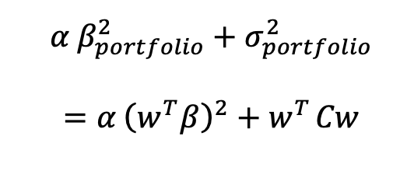

Market Neutral Optimization
Optimization Function:
$α$ is the Neutrality Preference Coefficient
$w= \left\{w_{1},…,w_{n}\right\}$ are our weights
$β=\left\{β_{1},…,β_{n}\right\}$ are the betas of the individual commodities: $β_{i}=\frac{cov\left(r_{i}, r_{mkt}\right)}{σ_{mkt}^{2}}$
$C$is the covariance matrix of returns
Data Cleaning
Trading Strategy
Optimization
Back Test

Slide 8
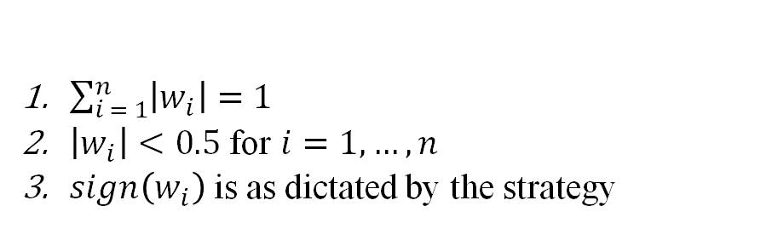
Market Neutral Optimization
Constraints:
$\sum_{i = 1}^{n}{\left|w_{i}\right|}=1$
$\left|w_{i}\right|<0.5$ for $i=1,…,n$
$sign\left(w_{i}\right)$ is as dictated by the strategy
Data Cleaning
Trading Strategy
Optimization
Back Test

Slide 9
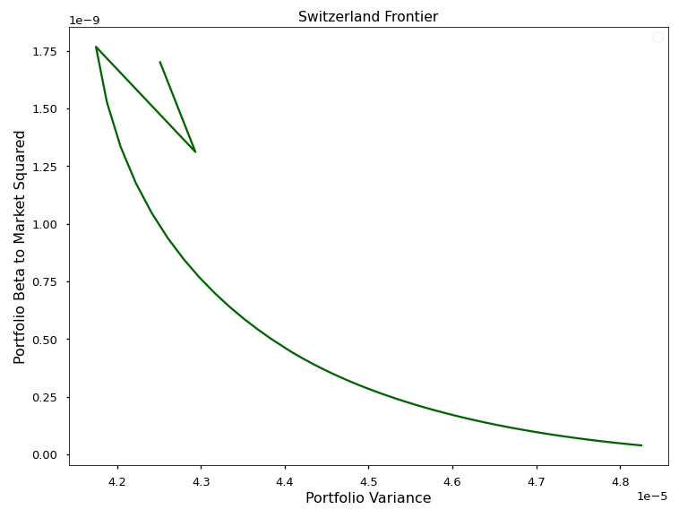
The “Switzerland” Frontier
Data Cleaning
Trading Strategy
Optimization
Back Test

Slide 10
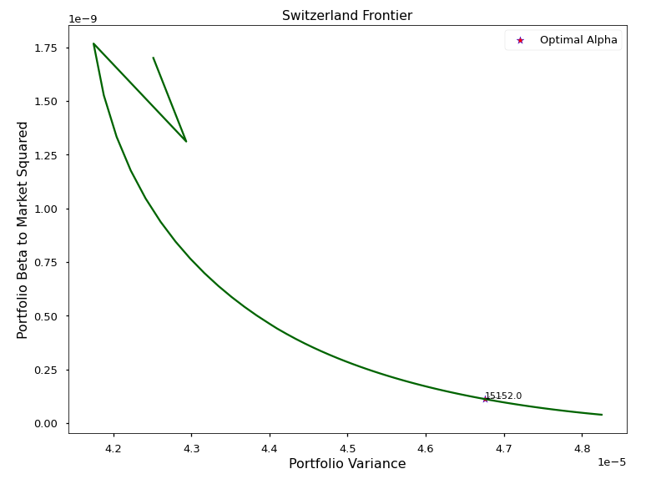
The "Switzerland" Frontier: ⍺ Deeper Dive
Data Cleaning
Trading Strategy
Optimization
Back Test

Slide 11
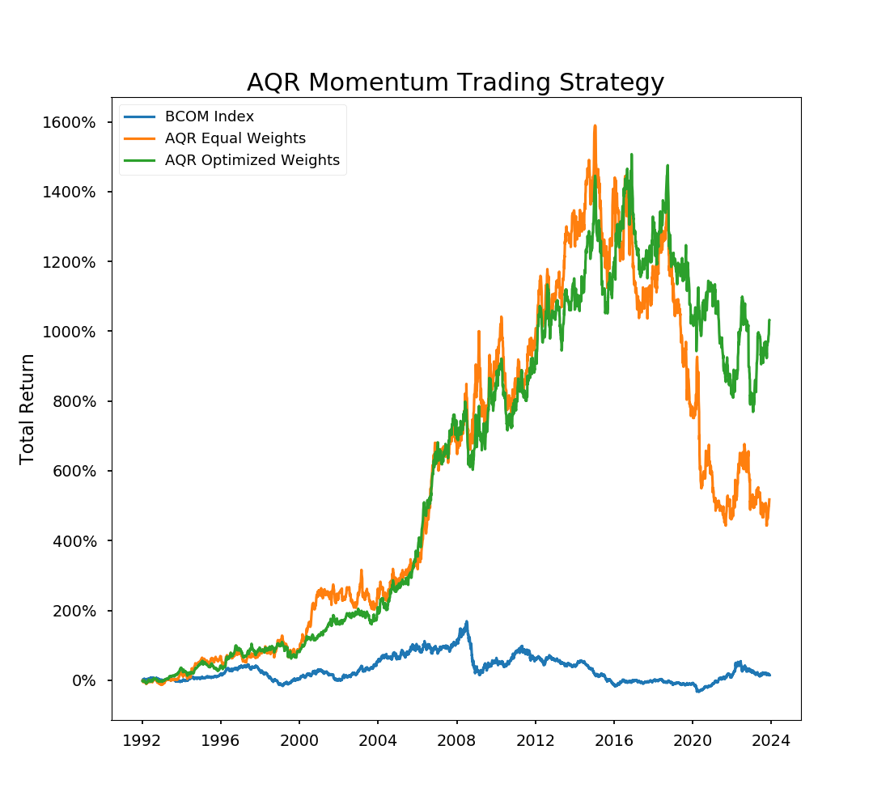
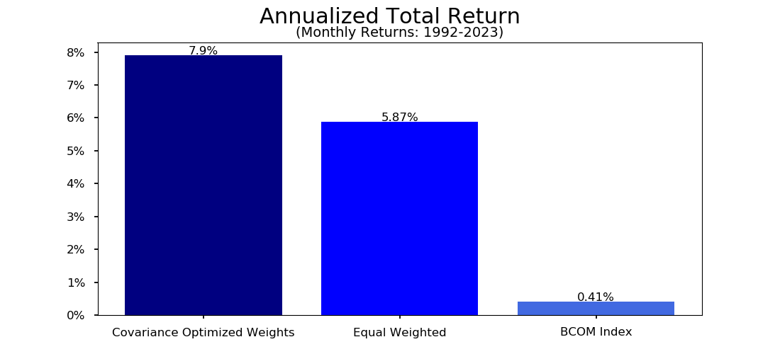
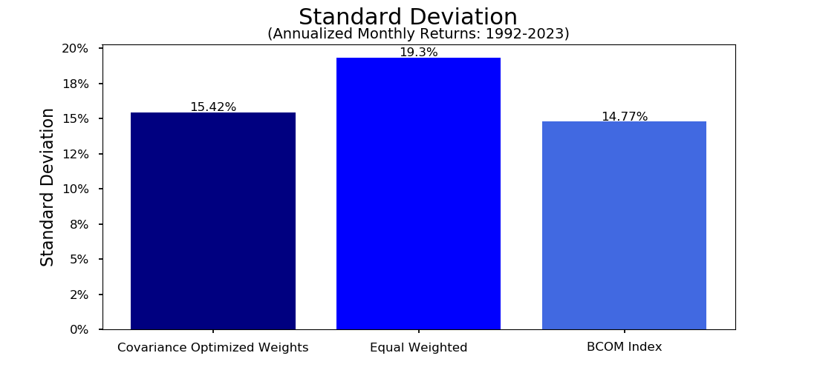
AQR Strategy Analysis
Data Cleaning
Trading Strategy
Optimization
Back Test

Slide 12
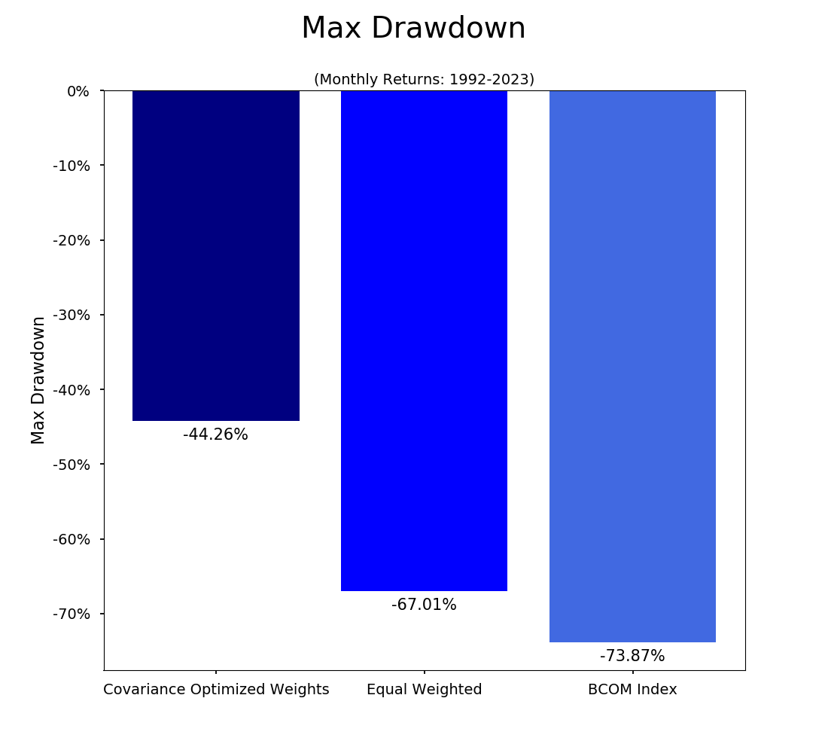
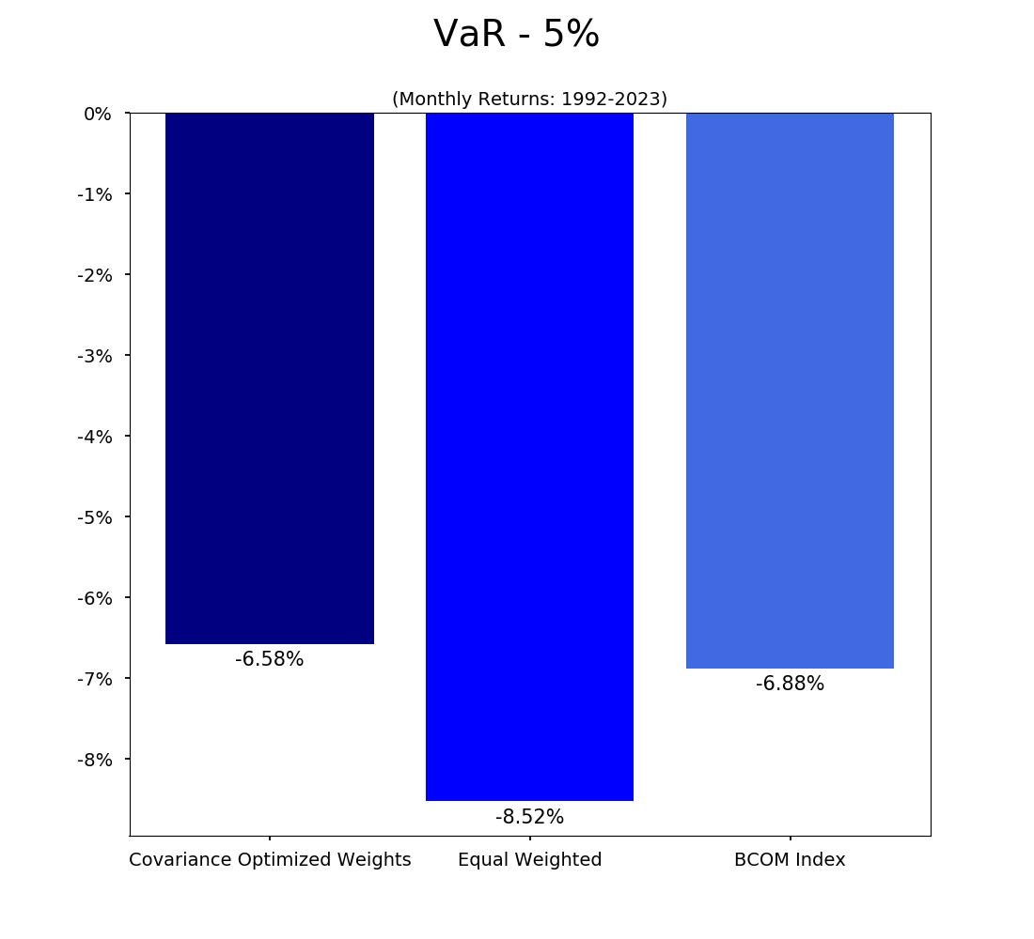
AQR Strategy Analysis
Data Cleaning
Trading Strategy
Optimization
Back Test

Slide 13
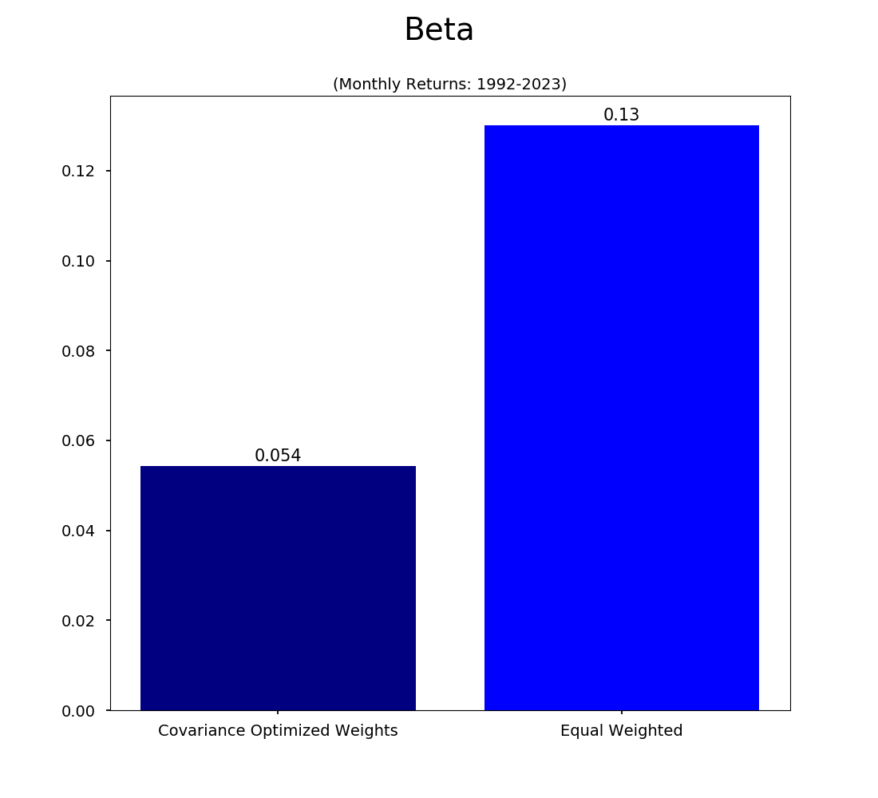
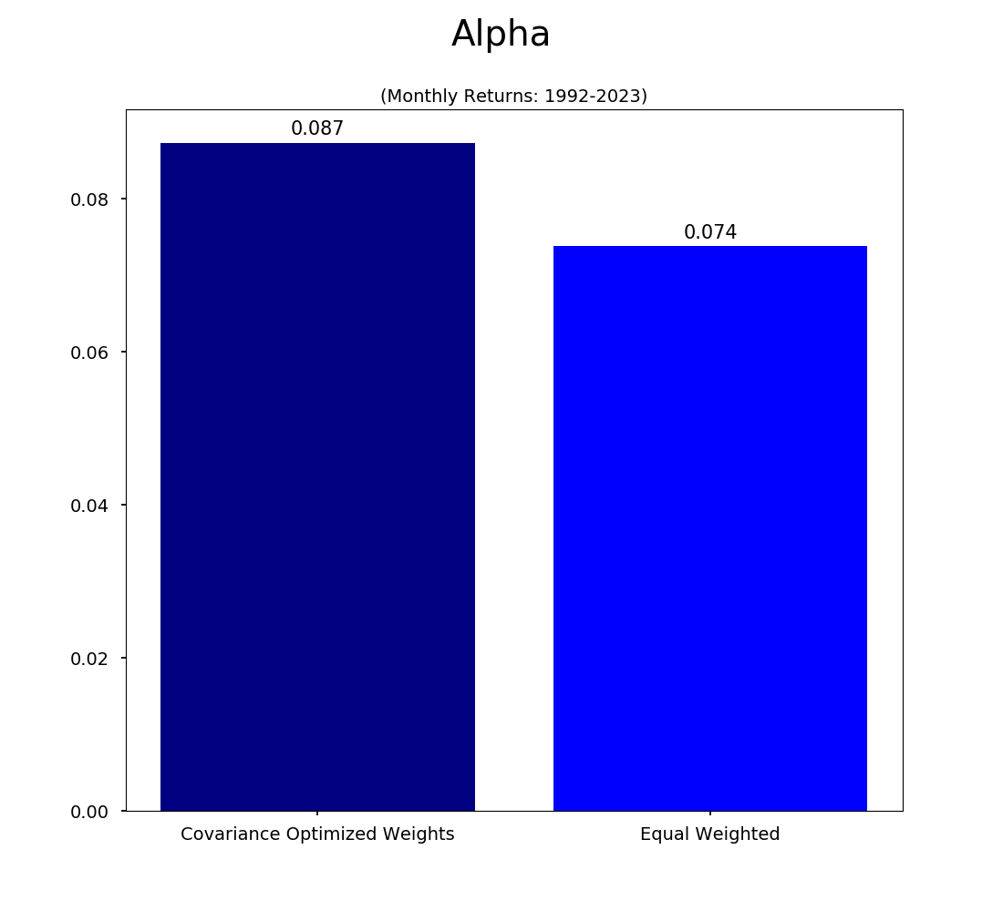
AQR Strategy Analysis
Data Cleaning
Trading Strategy
Optimization
Back Test

Slide 14
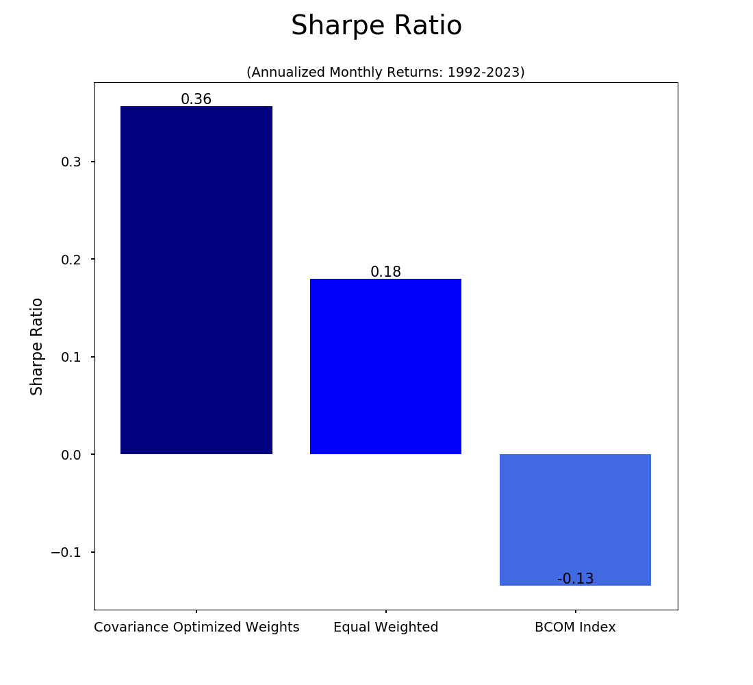
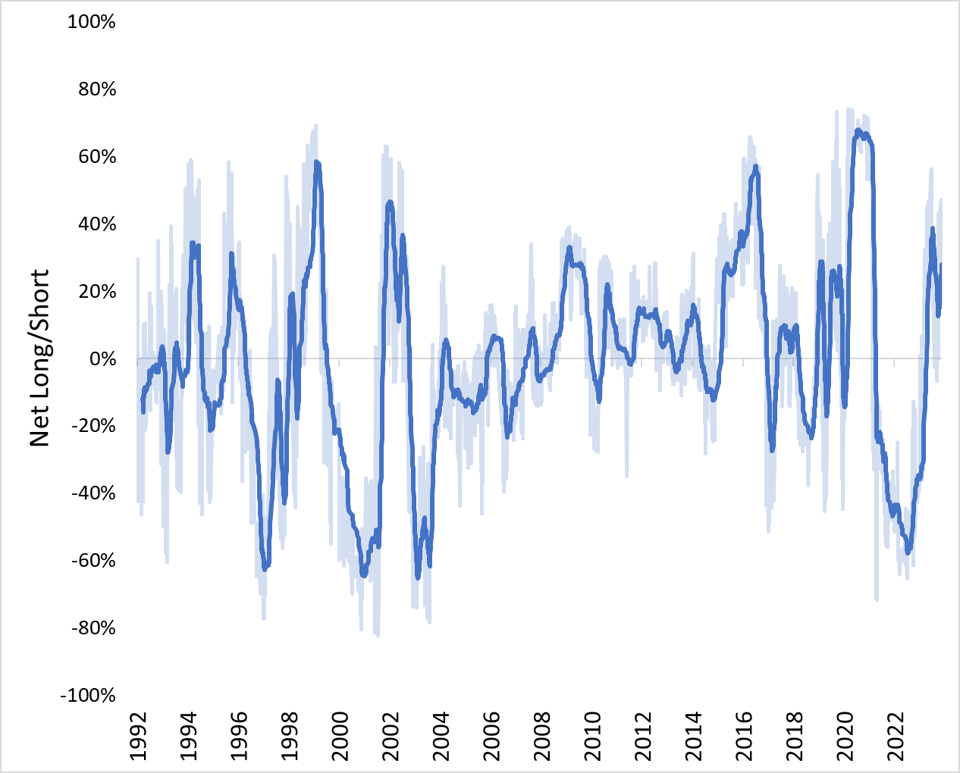
AQR Strategy Analysis
Portfolio Net Long/Short Position
(Covariance Optimized Portfolio)​
Data Cleaning
Trading Strategy
Optimization
Back Test

Slide 15
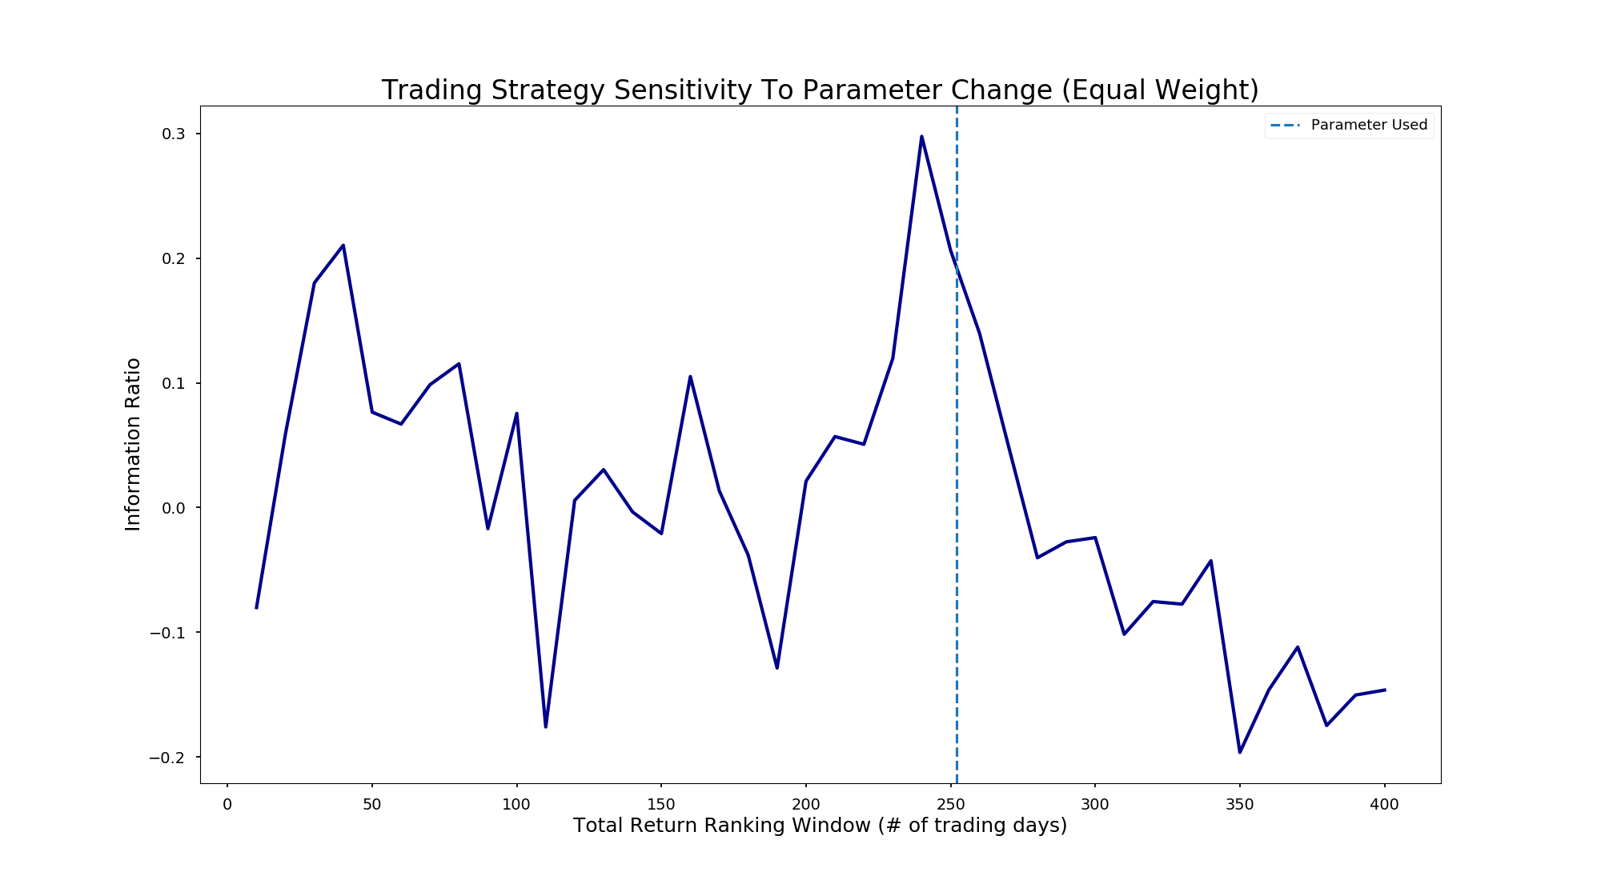
AQR Strategy Analysis
Data Cleaning
Trading Strategy
Optimization
Back Test

Slide 16
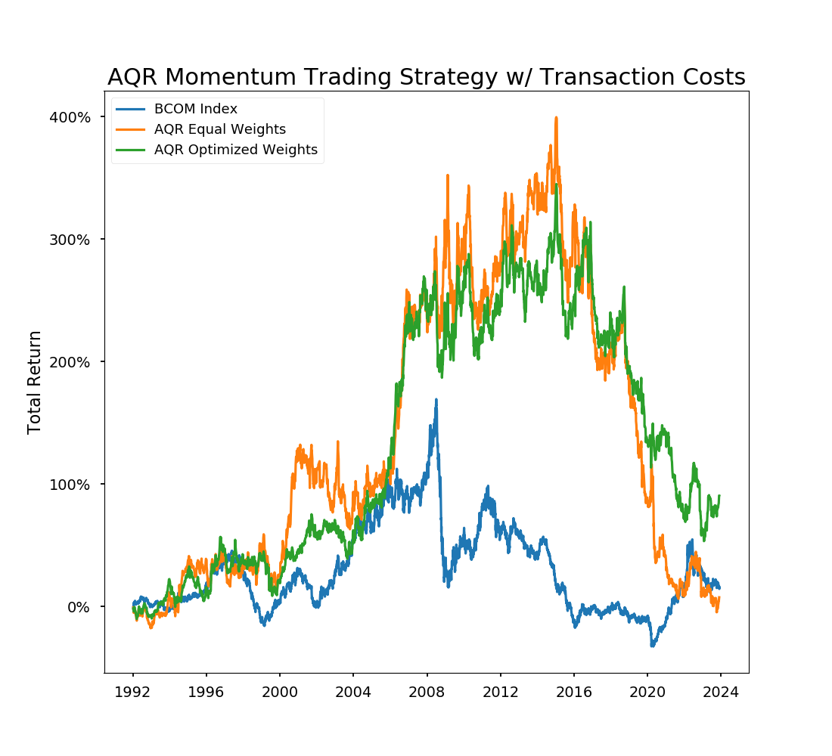
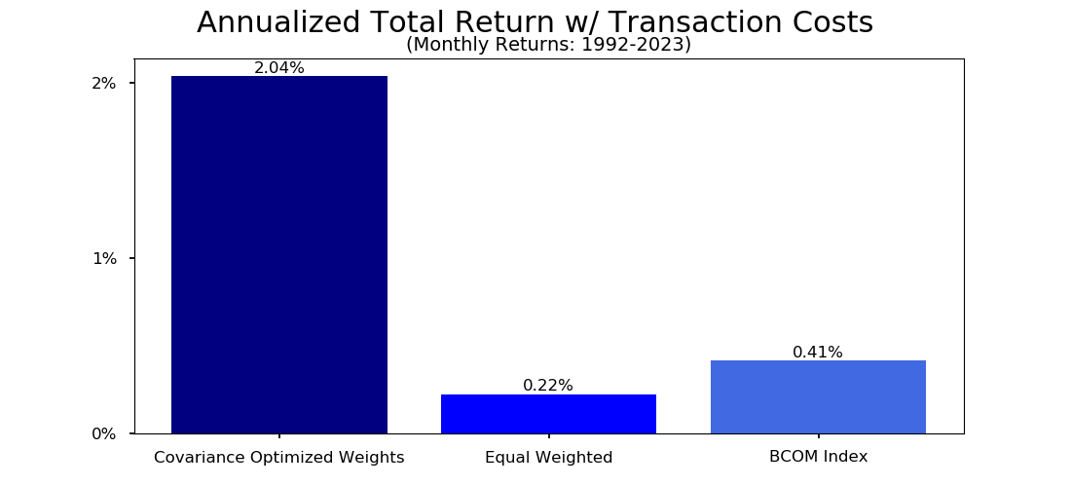
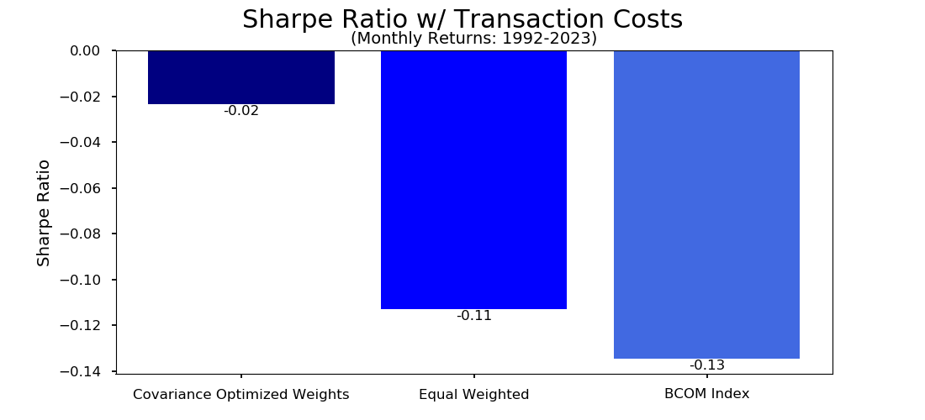
AQR Strategy Analysis - Transaction Costs
Data Cleaning
Trading Strategy
Optimization
Back Test

Slide 17
Conclusions, Limitations, and Future Research
Develop methods to manage transaction costs
Utilize more granular data than daily close
Explore leverage and futures specific trading consideration
Data Cleaning
Trading Strategy
Optimization
Back Test

Slide 18
Appendix

Slide 19
Git Link
Commodities Market Neutral Investment Strategy

